Slide 1
URAAN-CHANGING PERSPECTIVES

Slide 2
Group Members
Imad Rashid (17PWCSE1541)
Muhammad Nasir (17PWCSE1519)
Amna Abid (17PWCSE1531)

Slide 3
Project Progress
Splash Screen
Signin/Signup Screen
Signin
Signup
Admin Login
Member’s Login

Slide 4
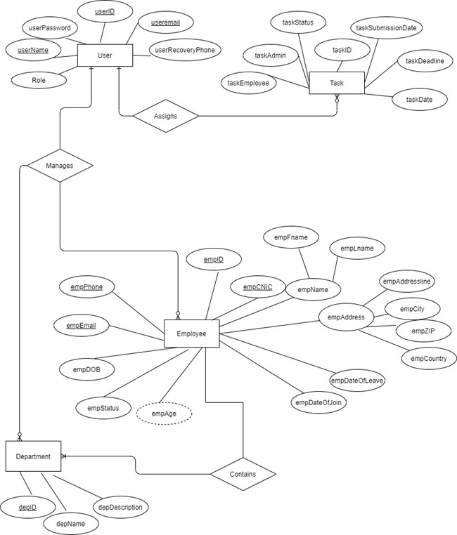
ERD https://drive.google.com/file/d/1nc2MkRvHA75HauYx2IfgZeaBea7vfXIc/view

Slide 5
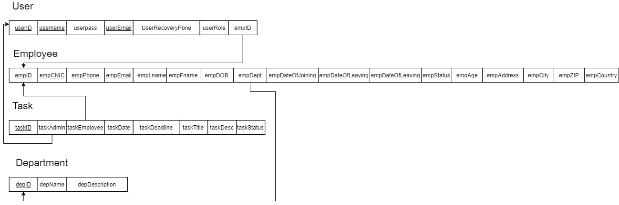
Logical Schema https://drive.google.com/file/d/17Ao5BQtORlds11OwjhkEJhTsRbMQS0aL/view

Slide 6
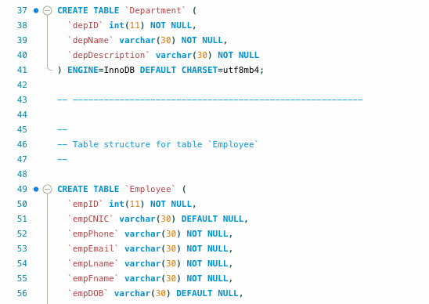
Database

Slide 7
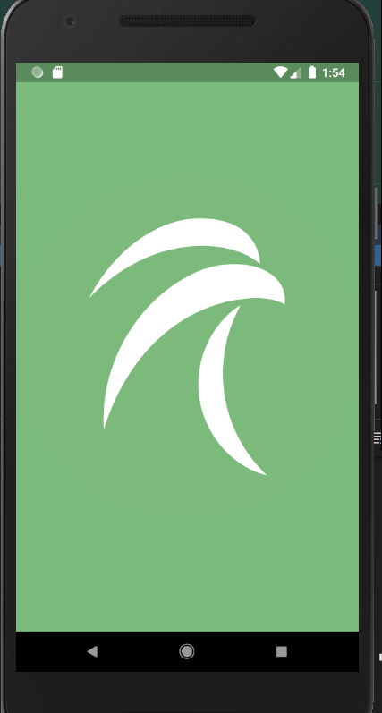
Splash Screen
Splash screen or Welcome screen is the first screen to be appeared in the app.

Slide 8
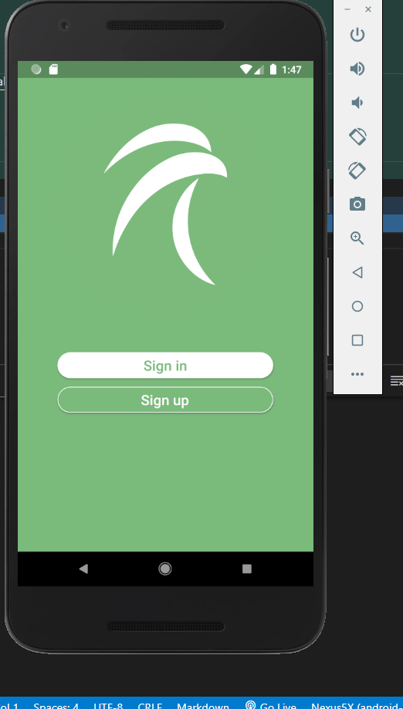
SignIn/SignUp
The next screen is the signin/signup screen.
If the user clicks signin, signin screen opens.
If signup is clicked, signup screen opens.

Slide 9
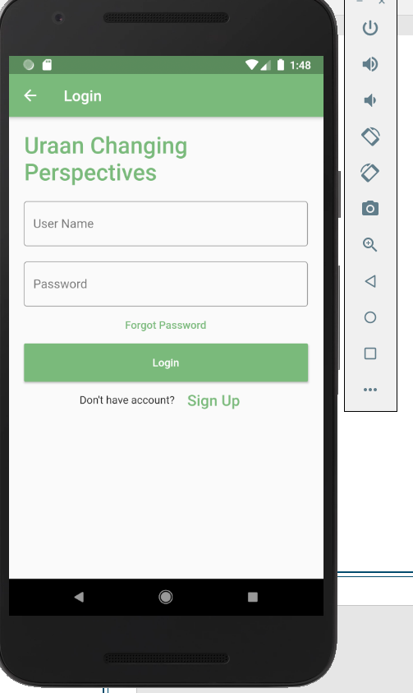
Signin/Login
If the user clicks signin, a screen will appear and the user is required to enter username and password.
Backend checks if user is admin or a member.
If user is admin, admin panel opens.
If user is general member, user dashboard opens.

Slide 10
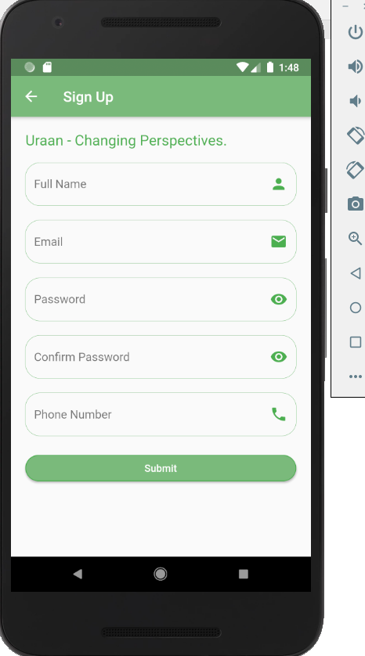
Signup
In the signup screen, user is required to enter the following details:
Full name
Email
Password
Phone number

Slide 11
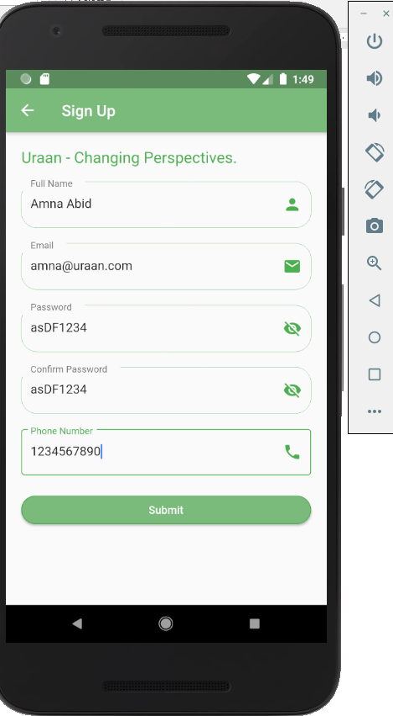
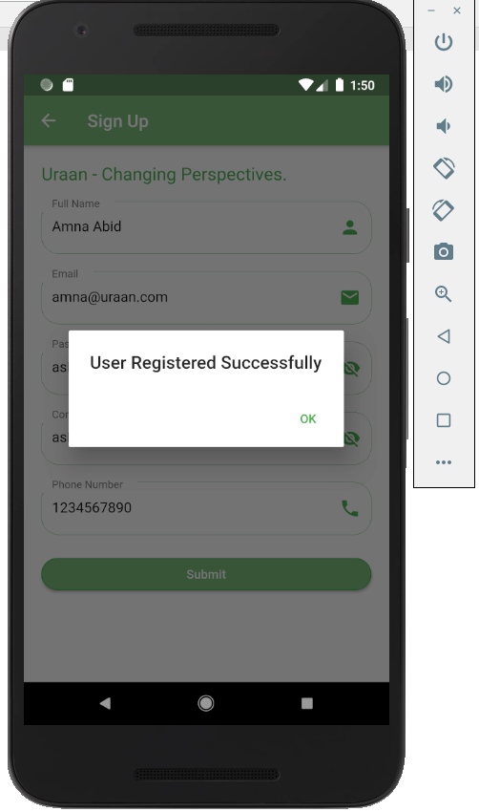
Signup
By default, every new user is registered as a general user.
Admins can only be added from database by administrators upon request

Slide 12
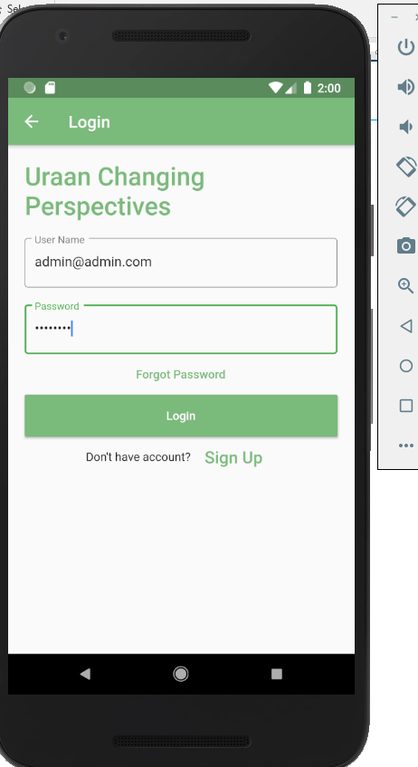
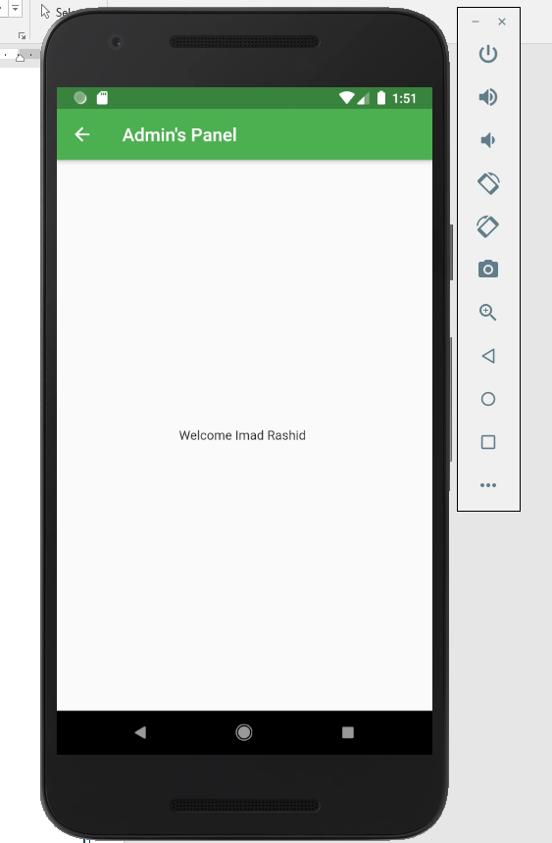
Admin Login
When user enters details in login, backend checks if it is admin aor a general member. If it is admin, admin panel opens.
We have registered admin account in database and the name of account holder is Imad Rashid.

Slide 13
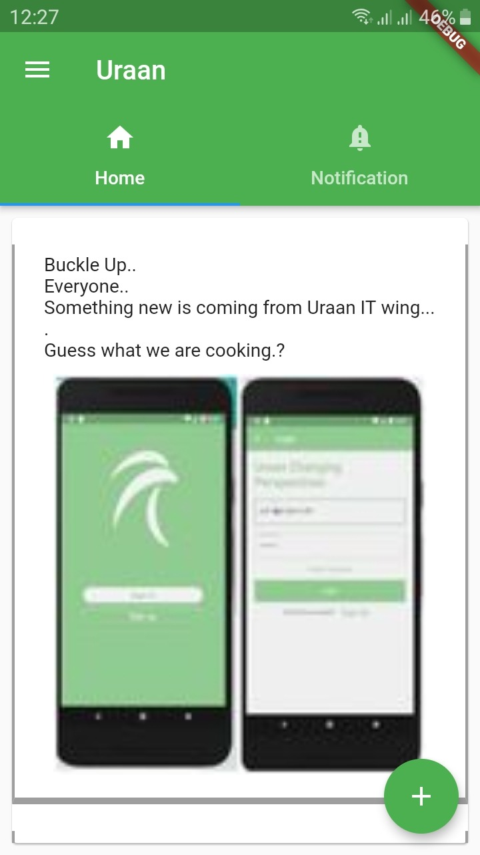
Admin
Admin Homescreen is linked with the official
facebook page of Uraan and it shows all the
fb posts.

Slide 14
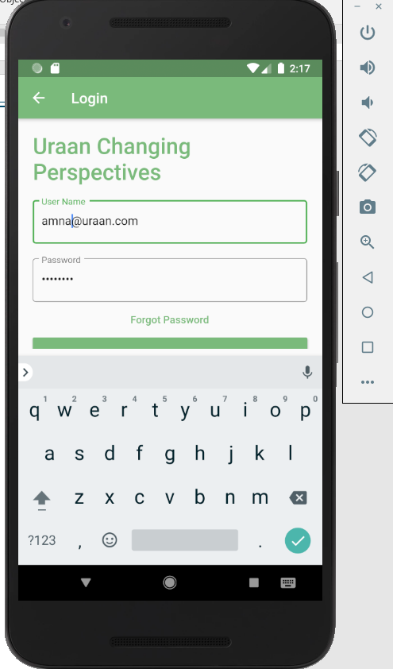
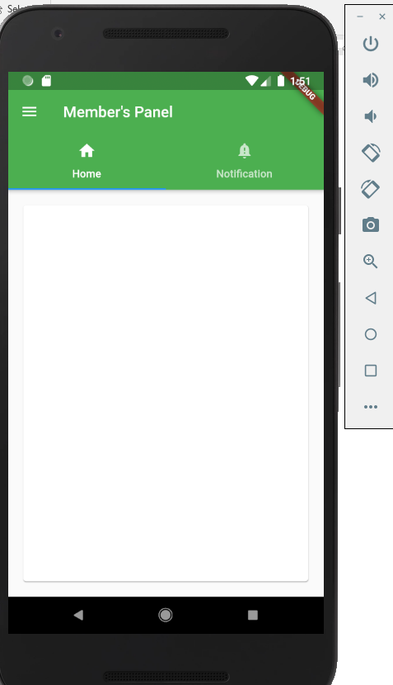
Member’s Login
When backend checks that it is a general member, it opens member dashboard or member’s panel.

Slide 15
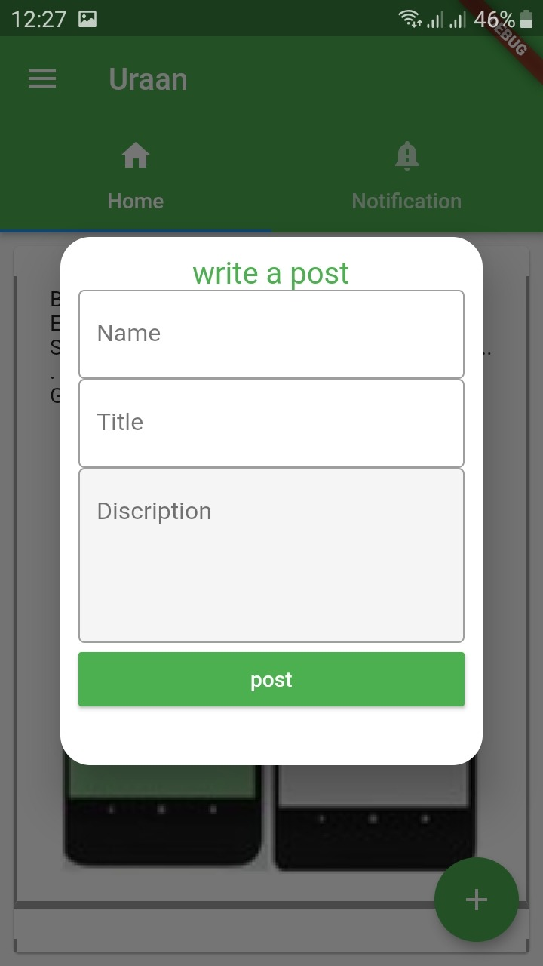
Admin
Plus sign is the task assignment. It is used to
assign a task to an employee or member.

Slide 16
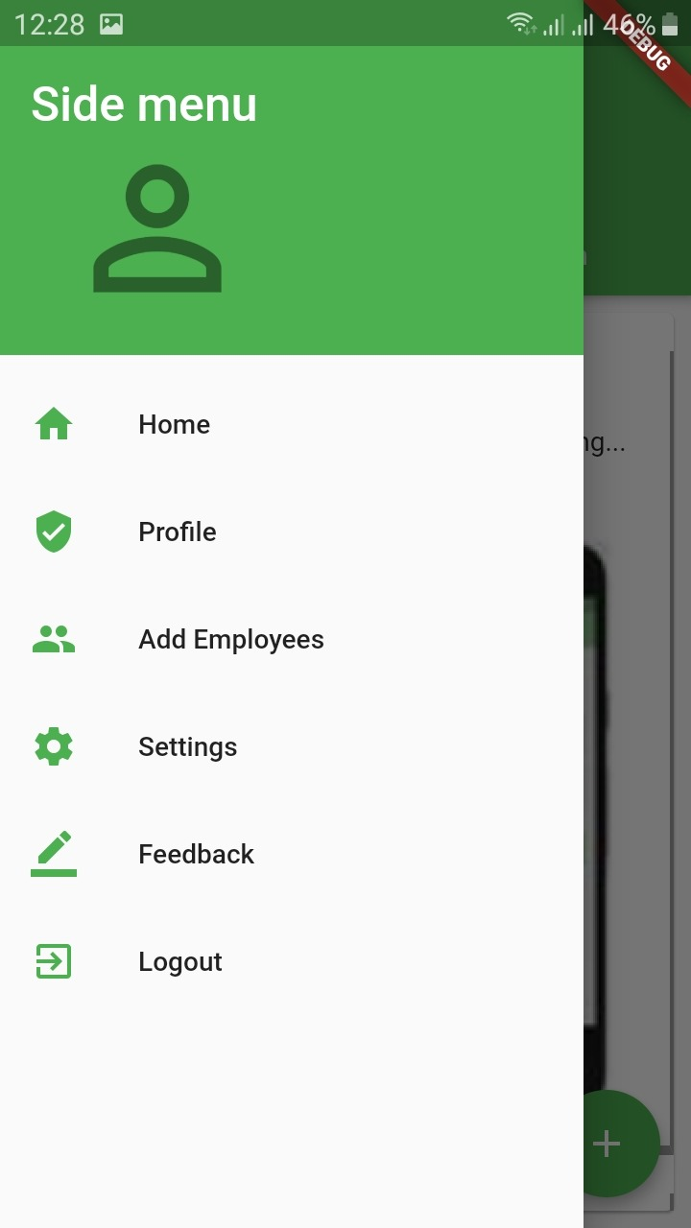
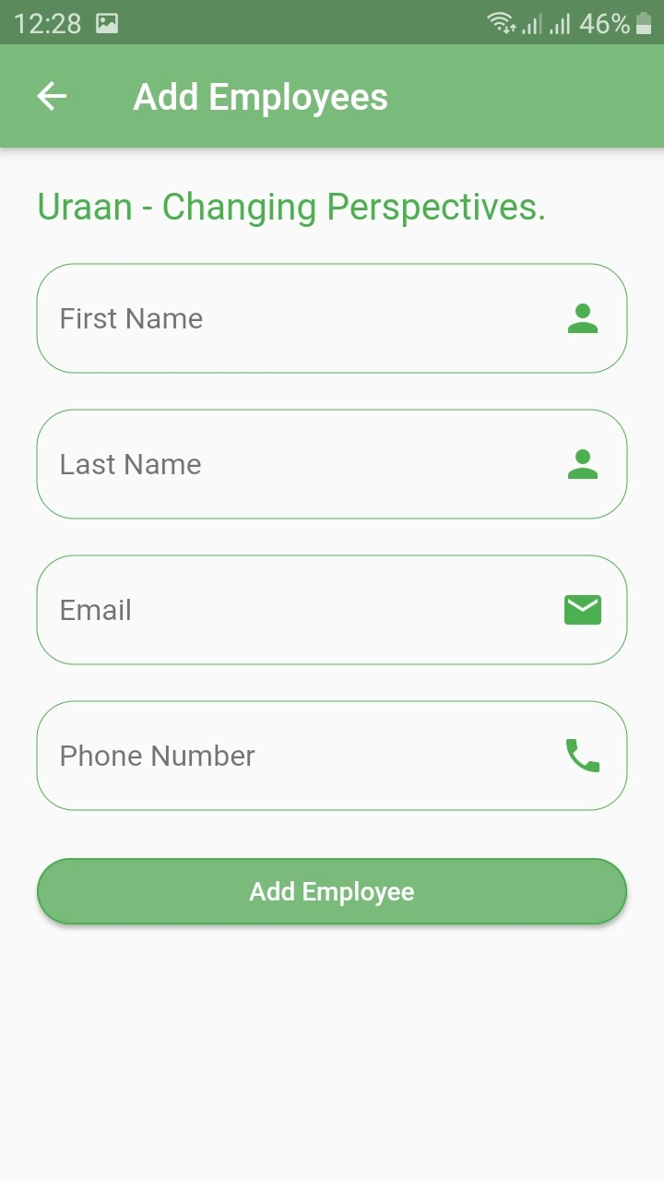
Admin – Add an Employee
Admin also have the option to add an employee.

Slide 17
THANK YOU!

